Slide 1

welcome
LIBRARY MANAGEMENT SYSTEM

Slide 2
TEAM MEMBERS
GROUP-03
Faria Zaman Oiky –41230301597
Sadia Afrin Kona-41230301614
Salsabil Akter Shifa-41230301600
Sehanur Rahman Seam-41230301589
Nazmun Nahar Kotha-41230301603

Slide 3
WHAT ARE THE FEATURES OF OUR LIBRARY MANAGEMENT SYSTEM?
In our system one can easily registration as a member.
Our system Can easily add books in the library by just providing book id, book name and the book will be saved in booklist file.
One can easily check available books in the library from view book feature.
Our system has a issue book management module with two feature
1. issue book() that allows to issue available books easily .
2. view issue book() which allows to see the persons who have issued book from the system to keep track.
e) one can easily search book from our system with search book feature. It will bring your desired book by just one click.
f) you can also delete available books from our system.

Slide 4
MODULE LIST
1.Member management
A)member registration
B) member login
2. Add book
3. View book
4. Issue book Management
A)Issue book
B)view issue book
5.Search book
6.Delete book
7.Pay Fine
8. Return book
9.Book Cataloging
0. Exit

Slide 5
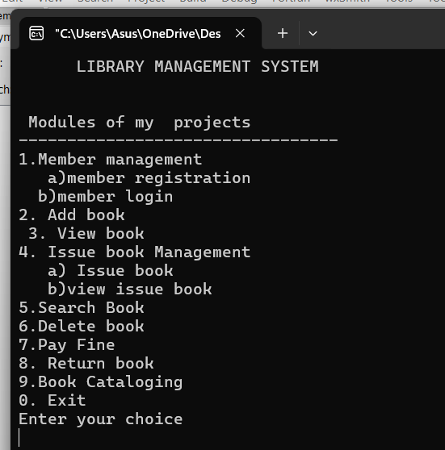
Output of module list

Slide 6
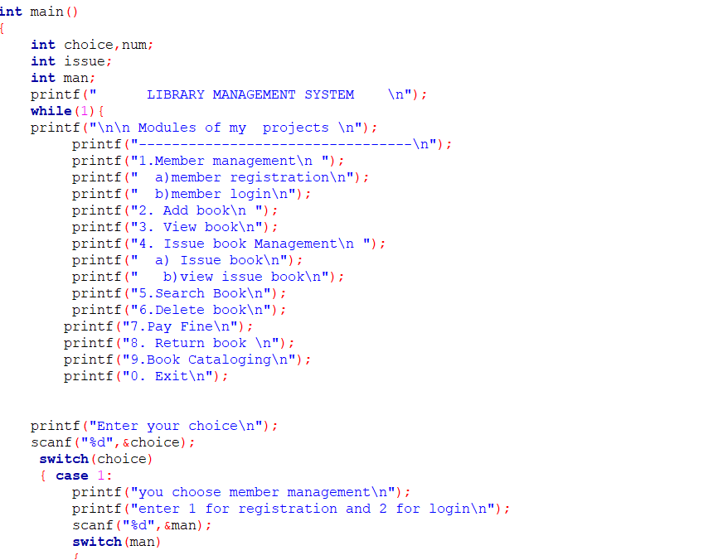
Code:

Slide 7
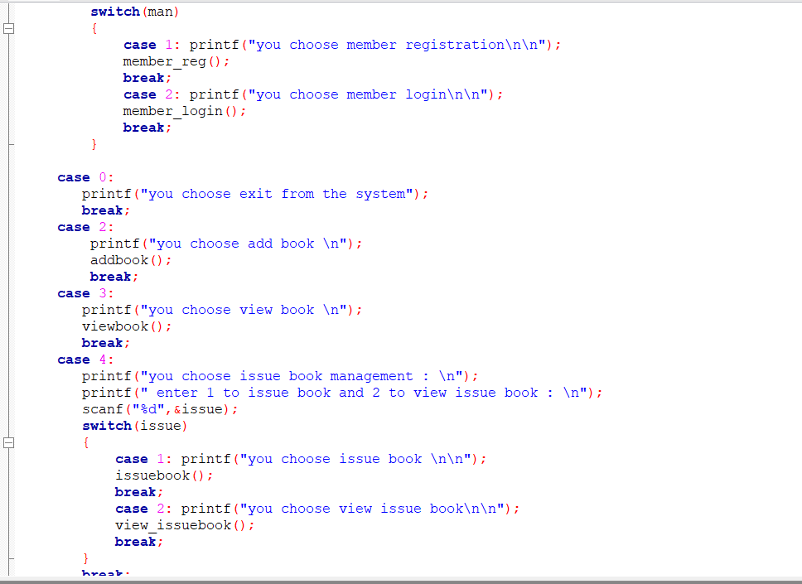

Slide 8
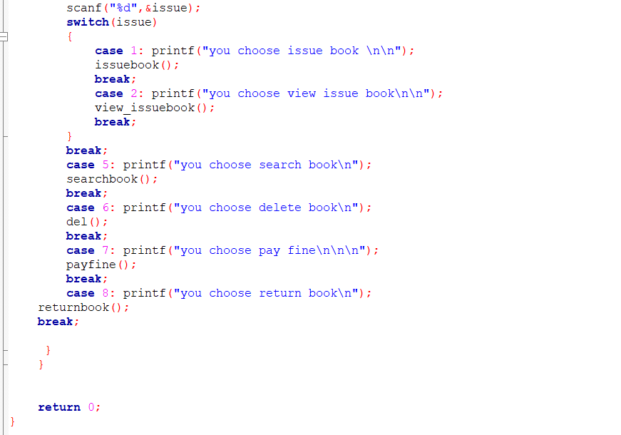

Slide 9
VIEW BOOK MODULE
USER STORY:
With the help of this module we will be able to have look on the available books in our library.
This module is applied by viewbook() function.
If a user choose the number 3 option then view book option will be applied. Then our program will show available books in the library.

Slide 10
pseudocode
1. Start
2. Clear screen
3. Display available books are
4. Display table headers book id book name author date
5. Open "booklist.txt" in binary read mode
6. WHILE reading book record from file is successful DO Print book ID, book name, author, and date in formatted columns
7. ENDWHILE
8. Close file
9. END

Slide 11
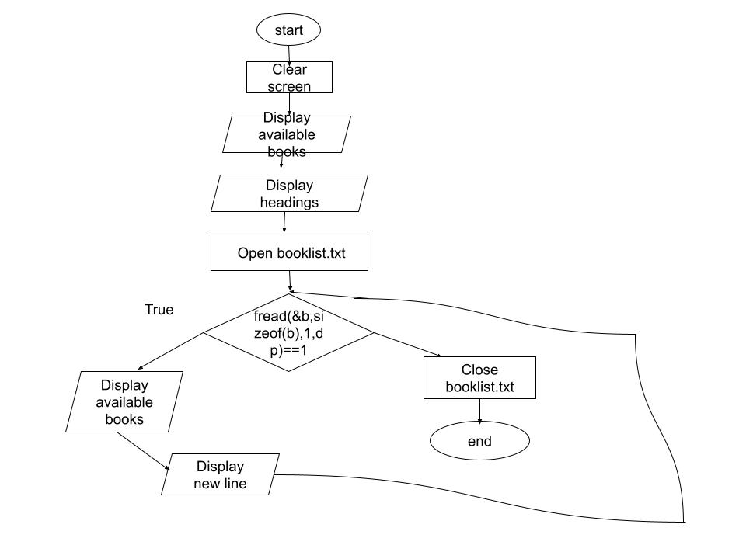
Flow chart

Slide 12
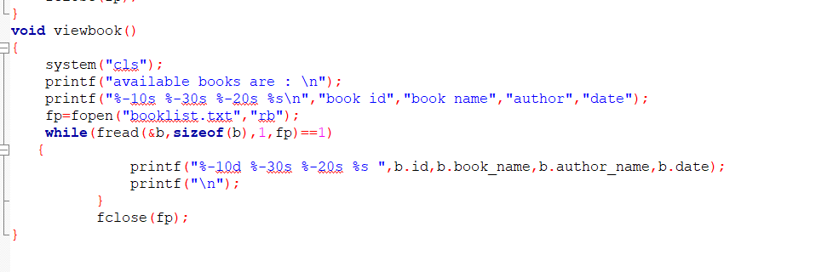
code

Slide 13
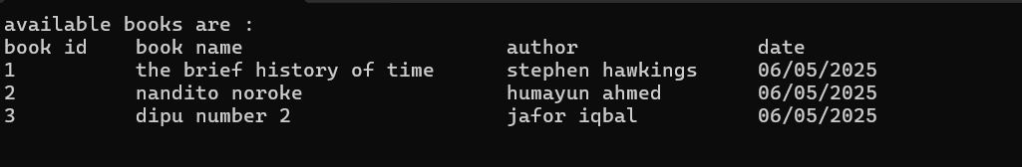
Output

Slide 14
Delete book module
USER STORY:
From the delete book module, users can remove books from the library system.
This function is executed through the del() function.
When a user selects the number 6 option in our program Function they got the message to enter the book ID.
If the book exists, it is removed from the record successfully.
If not found, the system informs the user that the record does not exist.

Slide 15
Pseudocode
Start
1. Declare id, f = 0
2. Clear screen
3. Display "Enter Book ID to remove"
4. Read id
5. Open "booklist.txt" as fp in binary read mode (rb)
6. Open "temp.txt" as ft in binary write mode (wb)

Slide 16
pseudocode
7. WHILE fread(&b, sizeof(b), 1, fp) == 1 DO I) IF id == b.id THEN a) Set f = 1 II) ELSE a) Write b to ft using fwrite(&b, sizeof(b), 1, ft) III) ENDIF END WHILE
8. IF f == 1 THEN I) Display "Deleted Successfully." ELSE I) Display "Record Not Found!" ENDIF
9. Close fp
10. Close ft
11. Delete "booklist.txt" using remove()
12. Rename "temp.txt" to "booklist.txt" using rename()
13. END

Slide 17
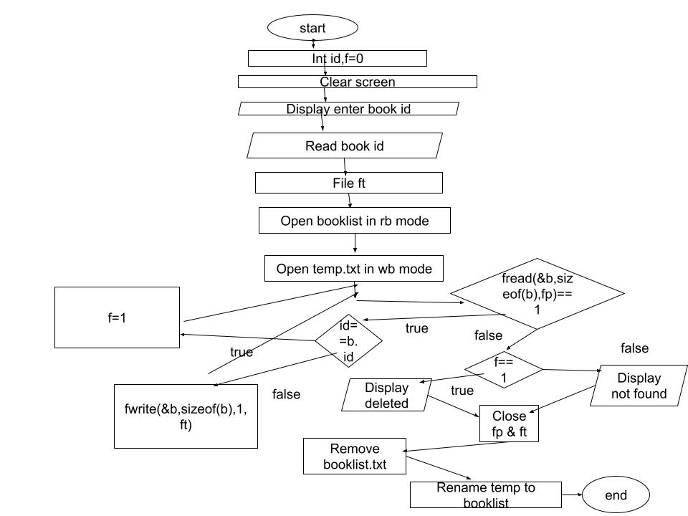
flowchart

Slide 18
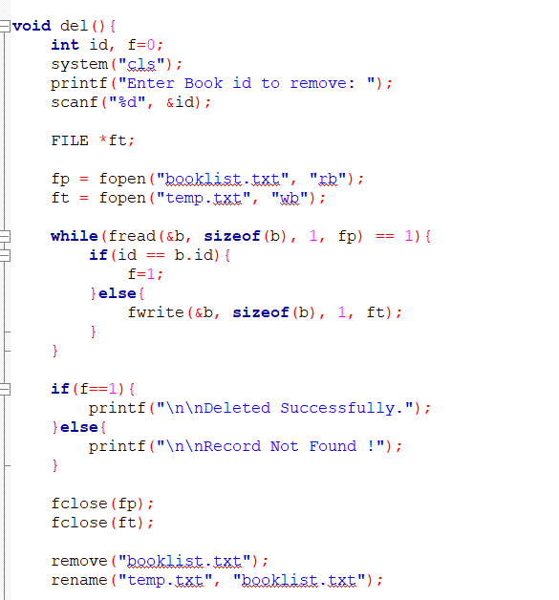
Code

Slide 19
code
void del()
{ int id, f=0;
system("cls");
printf("Enter Book id to remove: ");
scanf("%d", &id);
FILE *ft;
fp = fopen("booklist.txt", "rb");
ft = fopen("temp.txt", "wb");
while(fread(&b, sizeof(b), 1, fp) == 1)

Slide 20
{ if(id == b.id)
{ f=1; }
Else
{ fwrite(&b, sizeof(b), 1, ft); } }
if(f==1)
{ printf("\n\nDeleted Successfully."); }
else{ printf("\n\nRecord Not Found !"); }
fclose(fp); fclose(ft);
remove("booklist.txt");
rename("temp.txt", "booklist.txt"); }

Slide 21
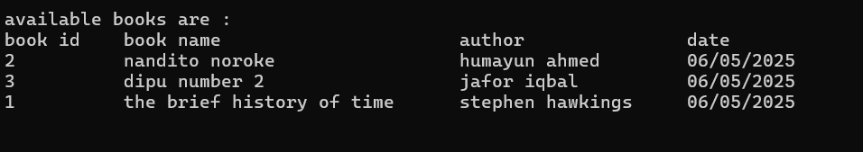
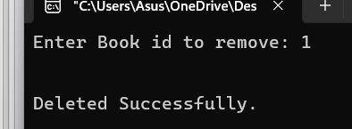
Output

Slide 22
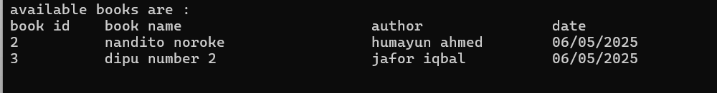

Slide 23
Conclusion
This Library Management System helps in registering members, adding books, viewing books, issuing books, viewing issuing books, searching book, deleting books. Users can sign up, and admins can manage book records easily. The system stores book and user data in files so that information is not lost when the program is closed. Users can see a list of available books, and they can also issue books. However, due to limited time, we could only complete these main features. We were unable to add book return, fine payment, and book cataloging modules. In the future, we can improve the system by adding these missing features. Even with these limitations, this project provides a strong base for a full library system.

Slide 24
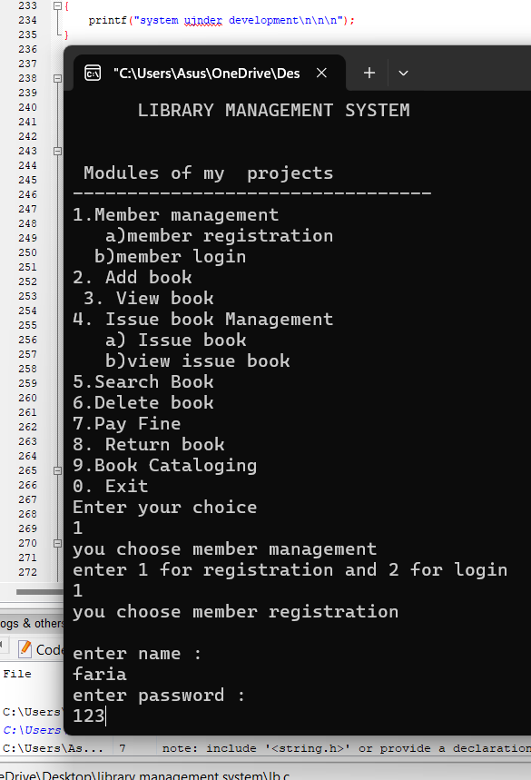
Output of our code:

Slide 25
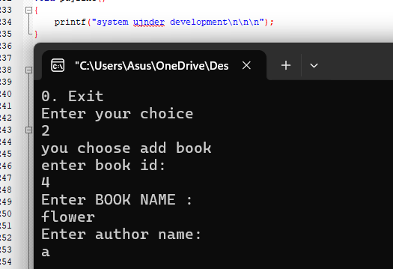
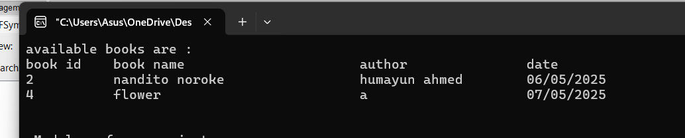
Add book output:

Slide 26
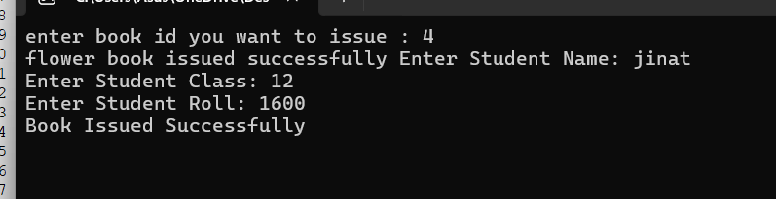
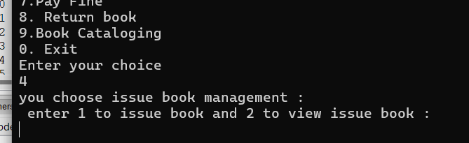
Issue management output

Slide 27
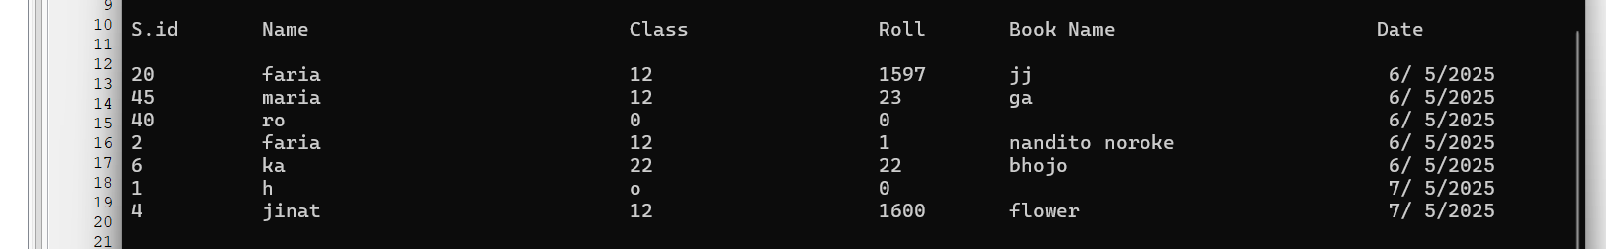
View issued books

Slide 28
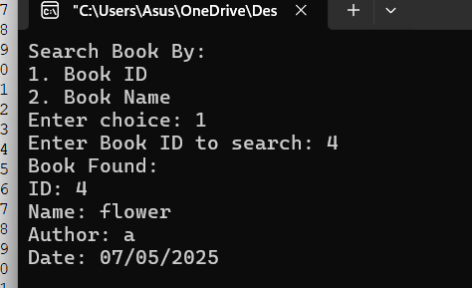
Search book output

Slide 29
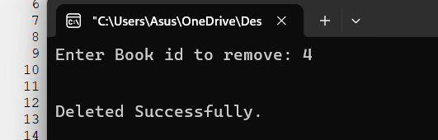
Delete book output

Slide 30
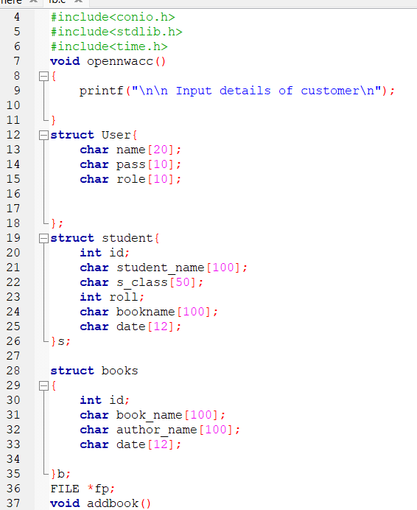
code

Slide 31
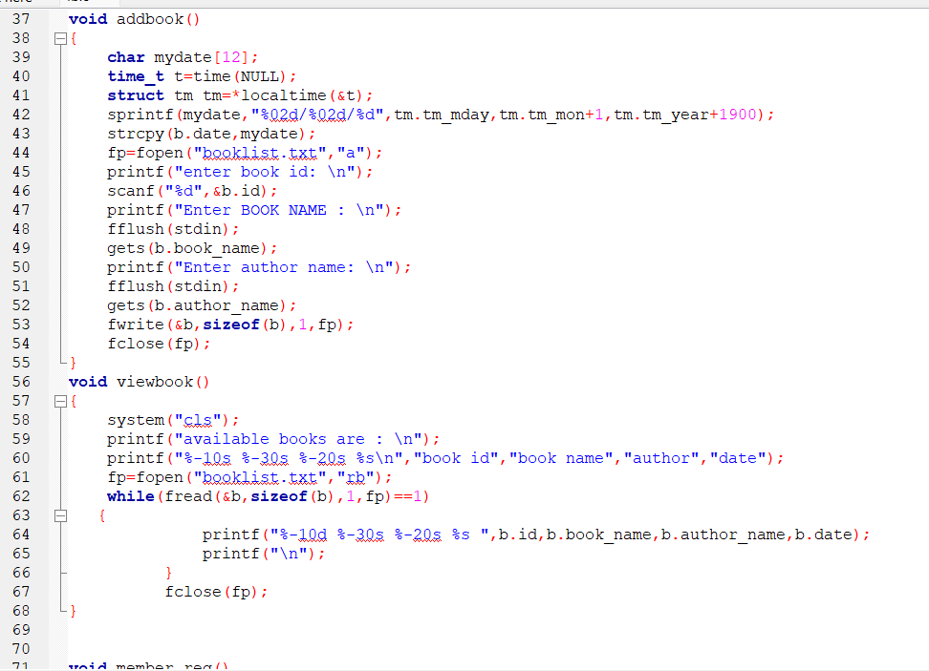

Slide 32
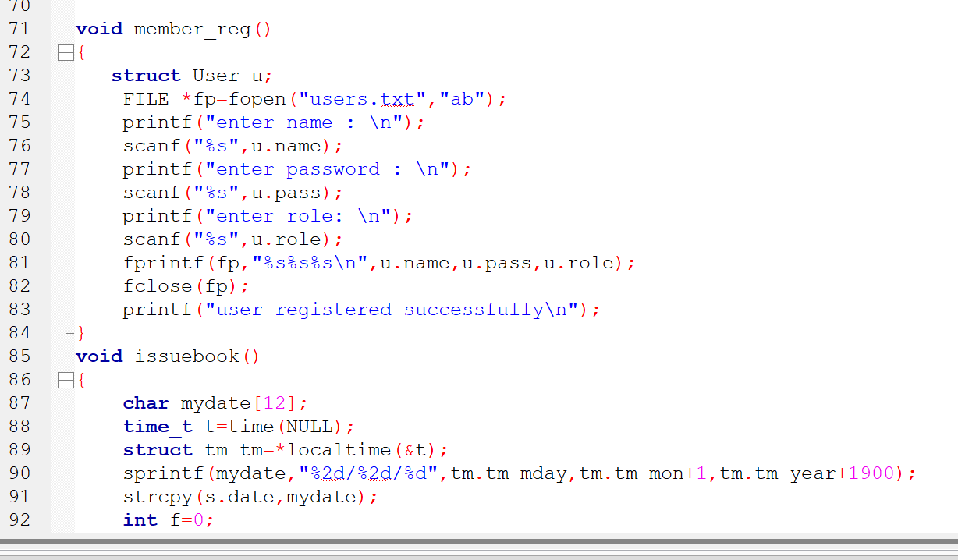

Slide 33
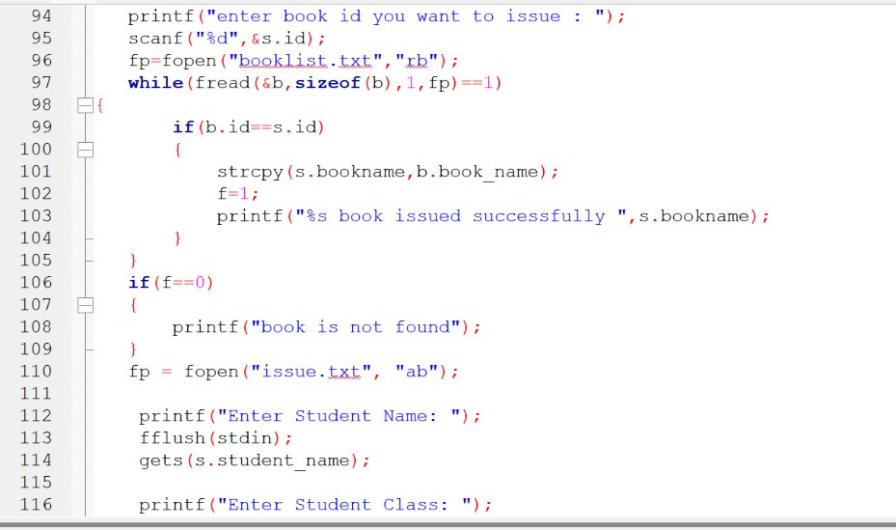

Slide 34
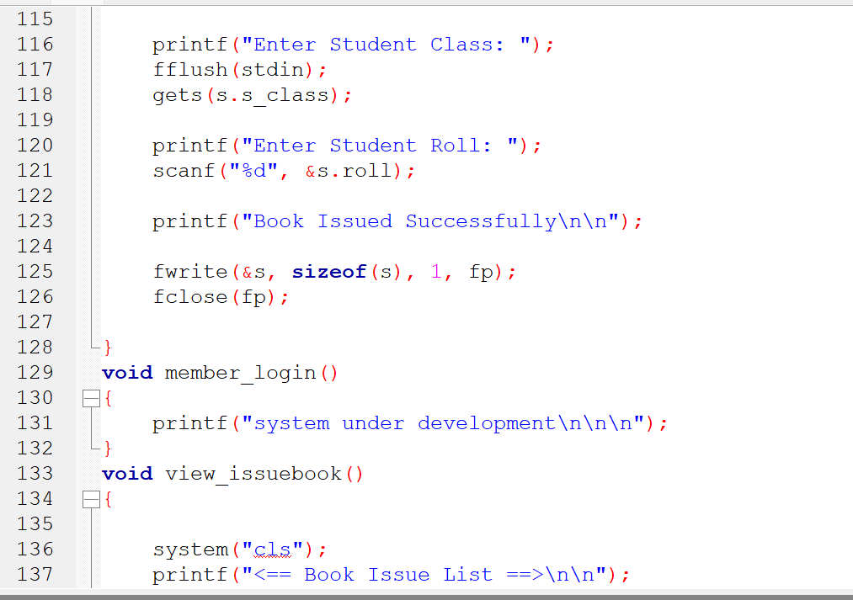

Slide 35
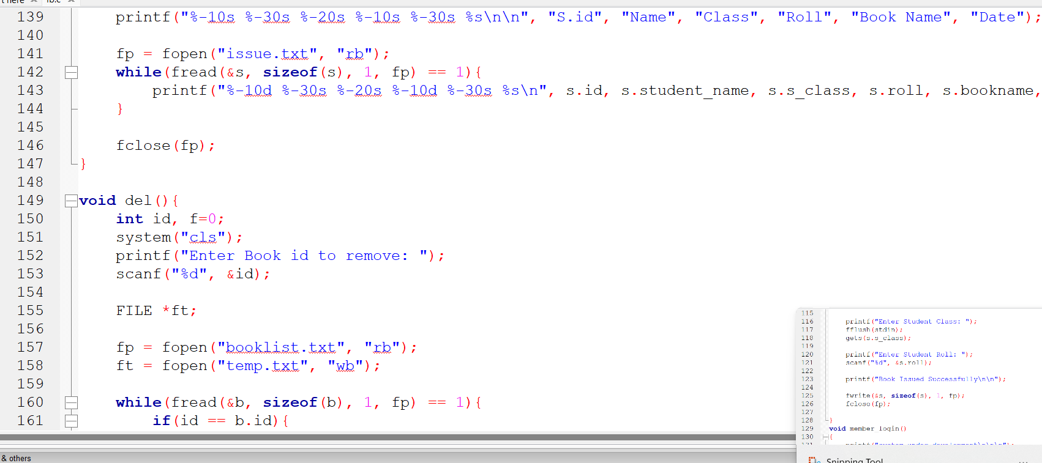

Slide 36
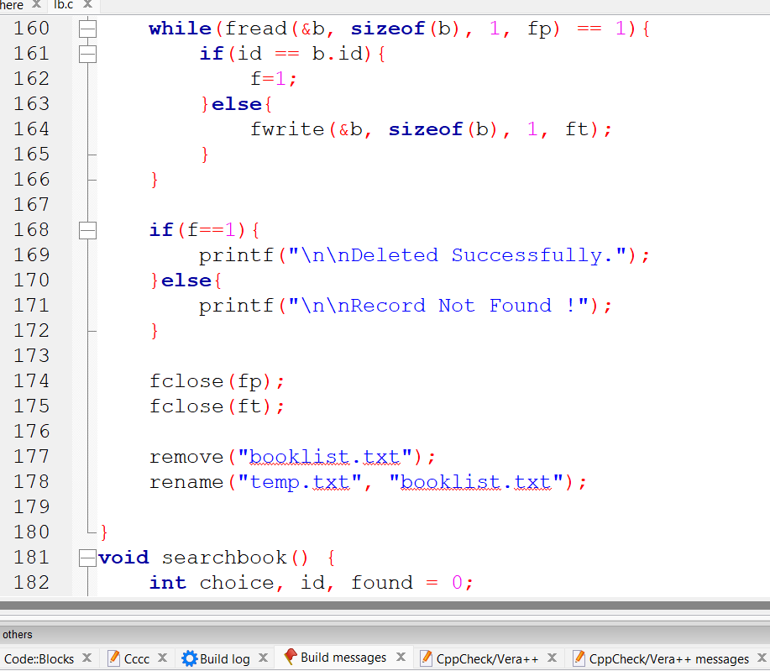

Slide 37
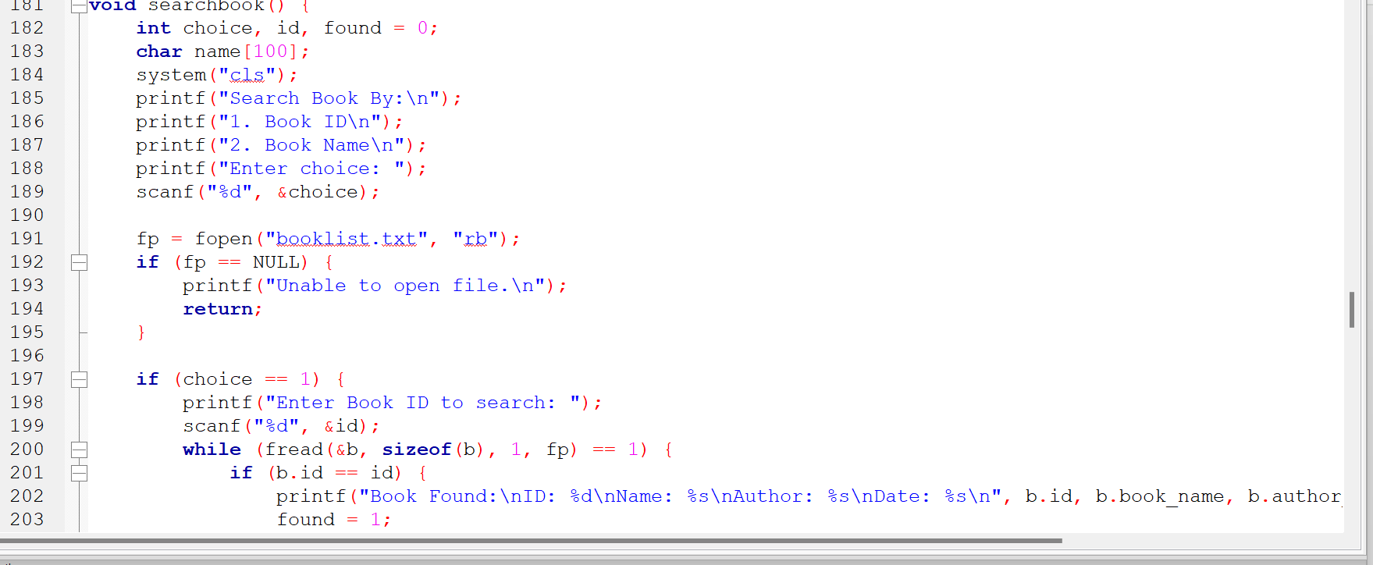

Slide 38
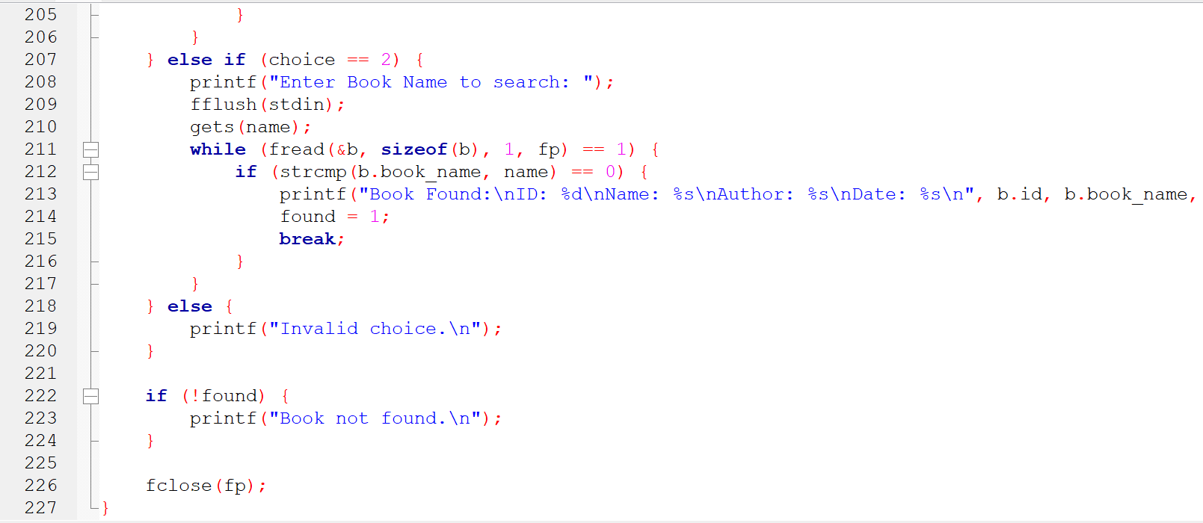

Slide 39
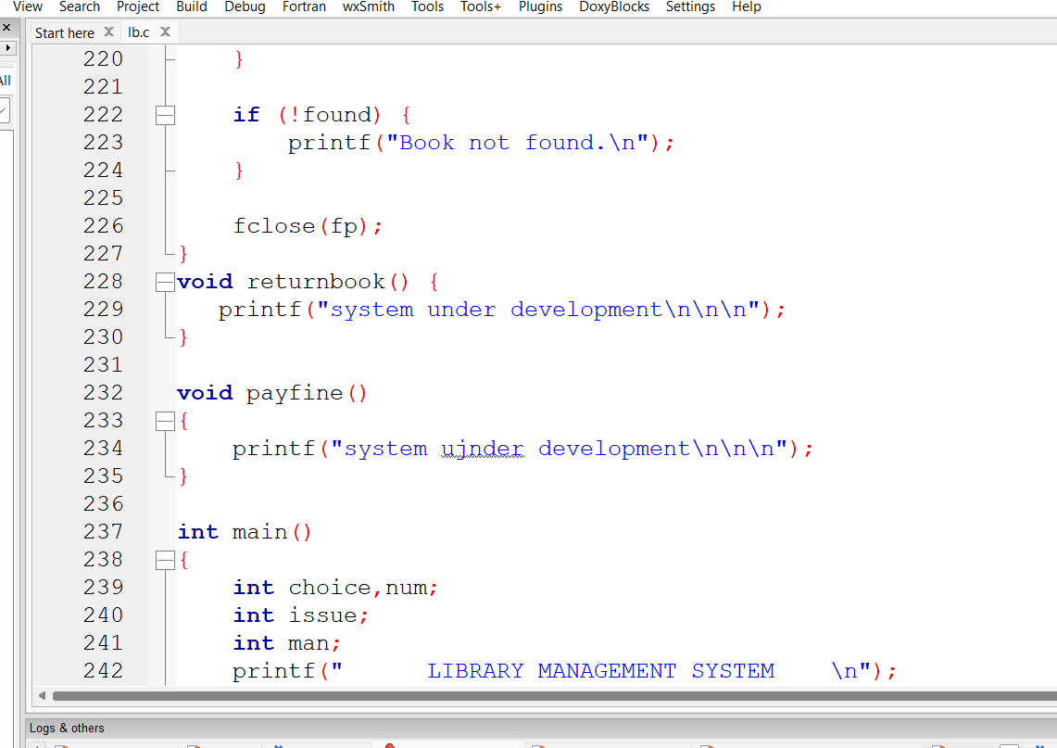

Slide 40
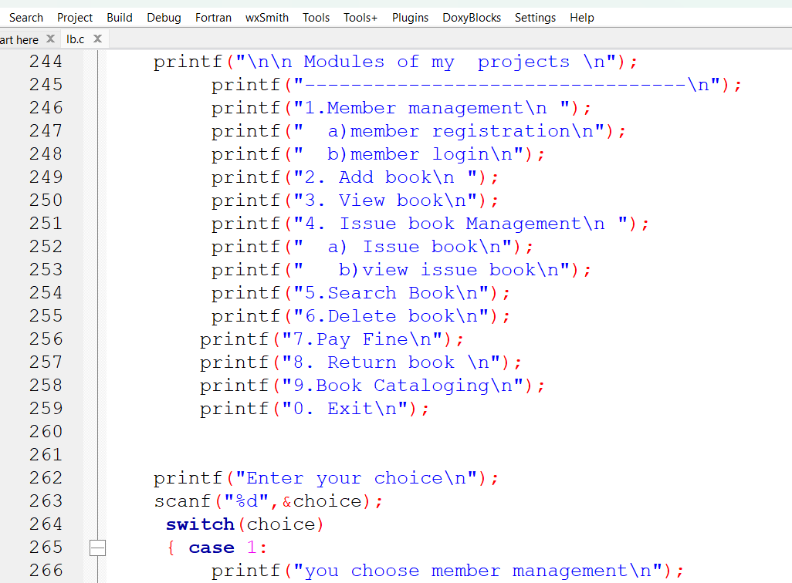

Slide 41
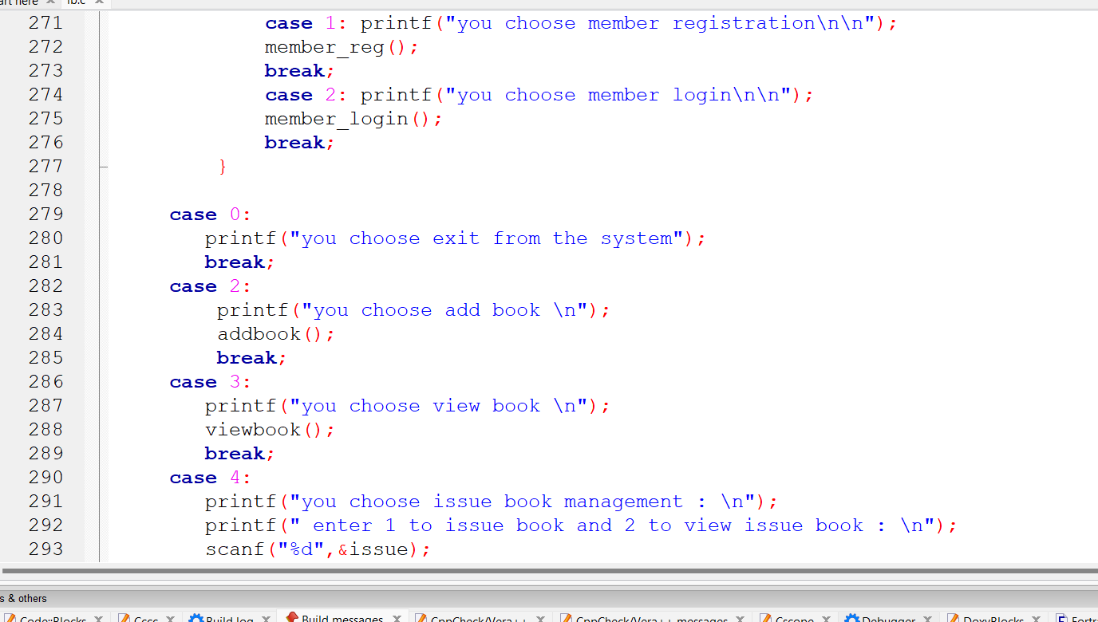

Slide 42
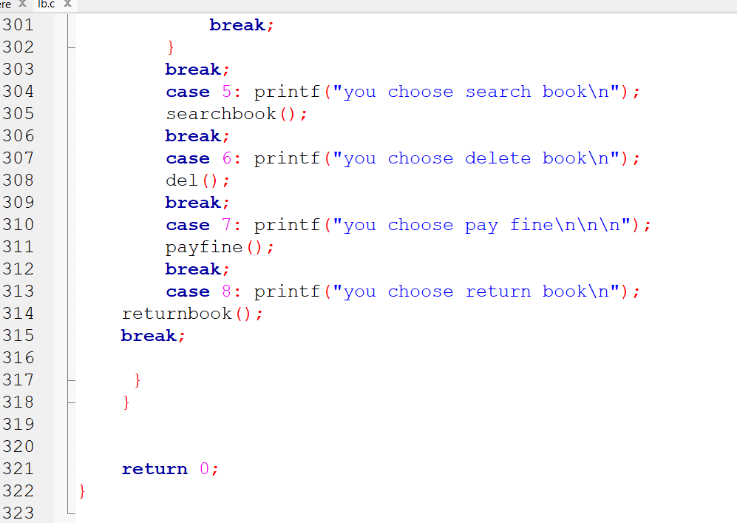

Slide 43
Thank you
.

